Slide 1
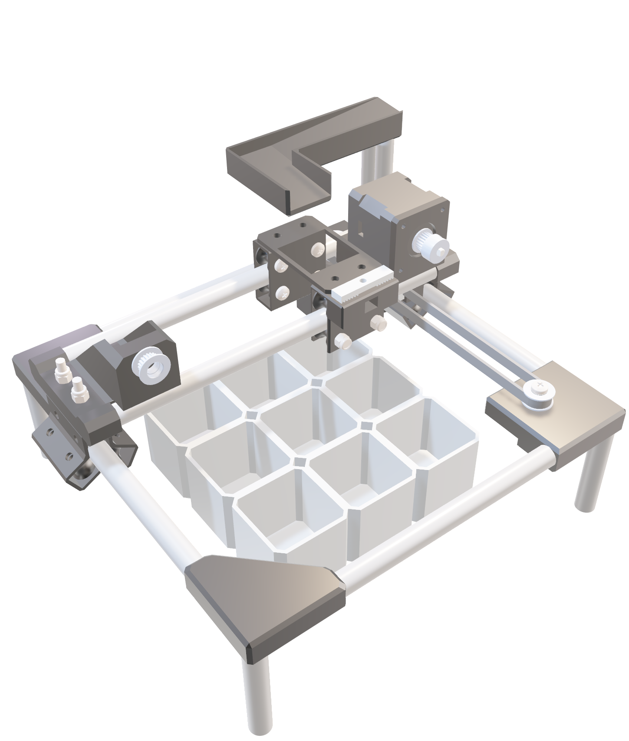
BRICK
CMPE Project – Group #11
BY
BRICK

Slide 2
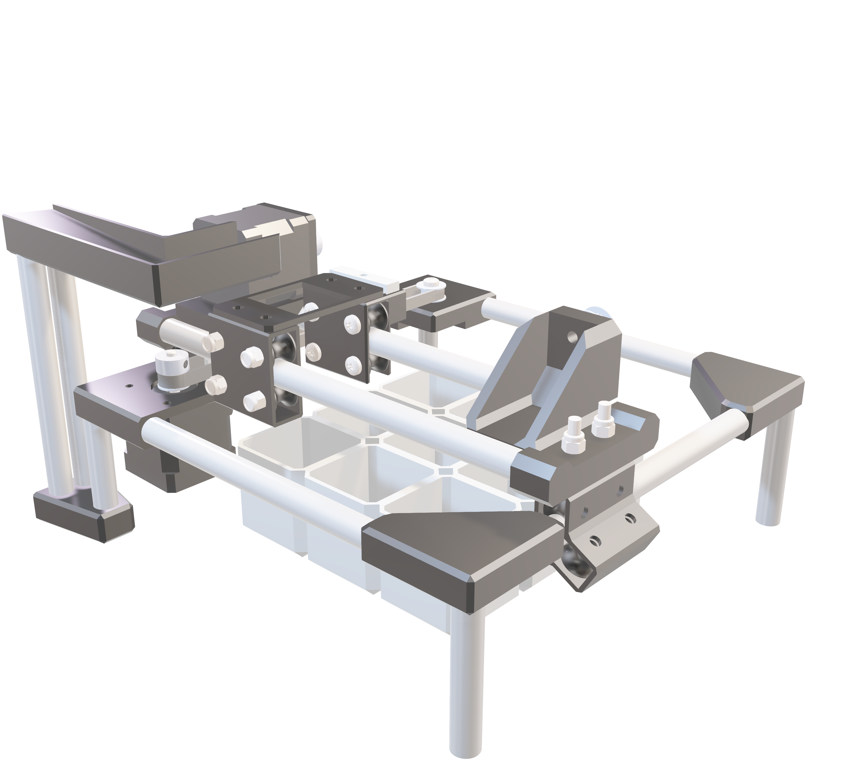
ai-powered vision. precision sorting. build without limitations.
BRICK
Project Overview
BY
BRICK

Slide 3


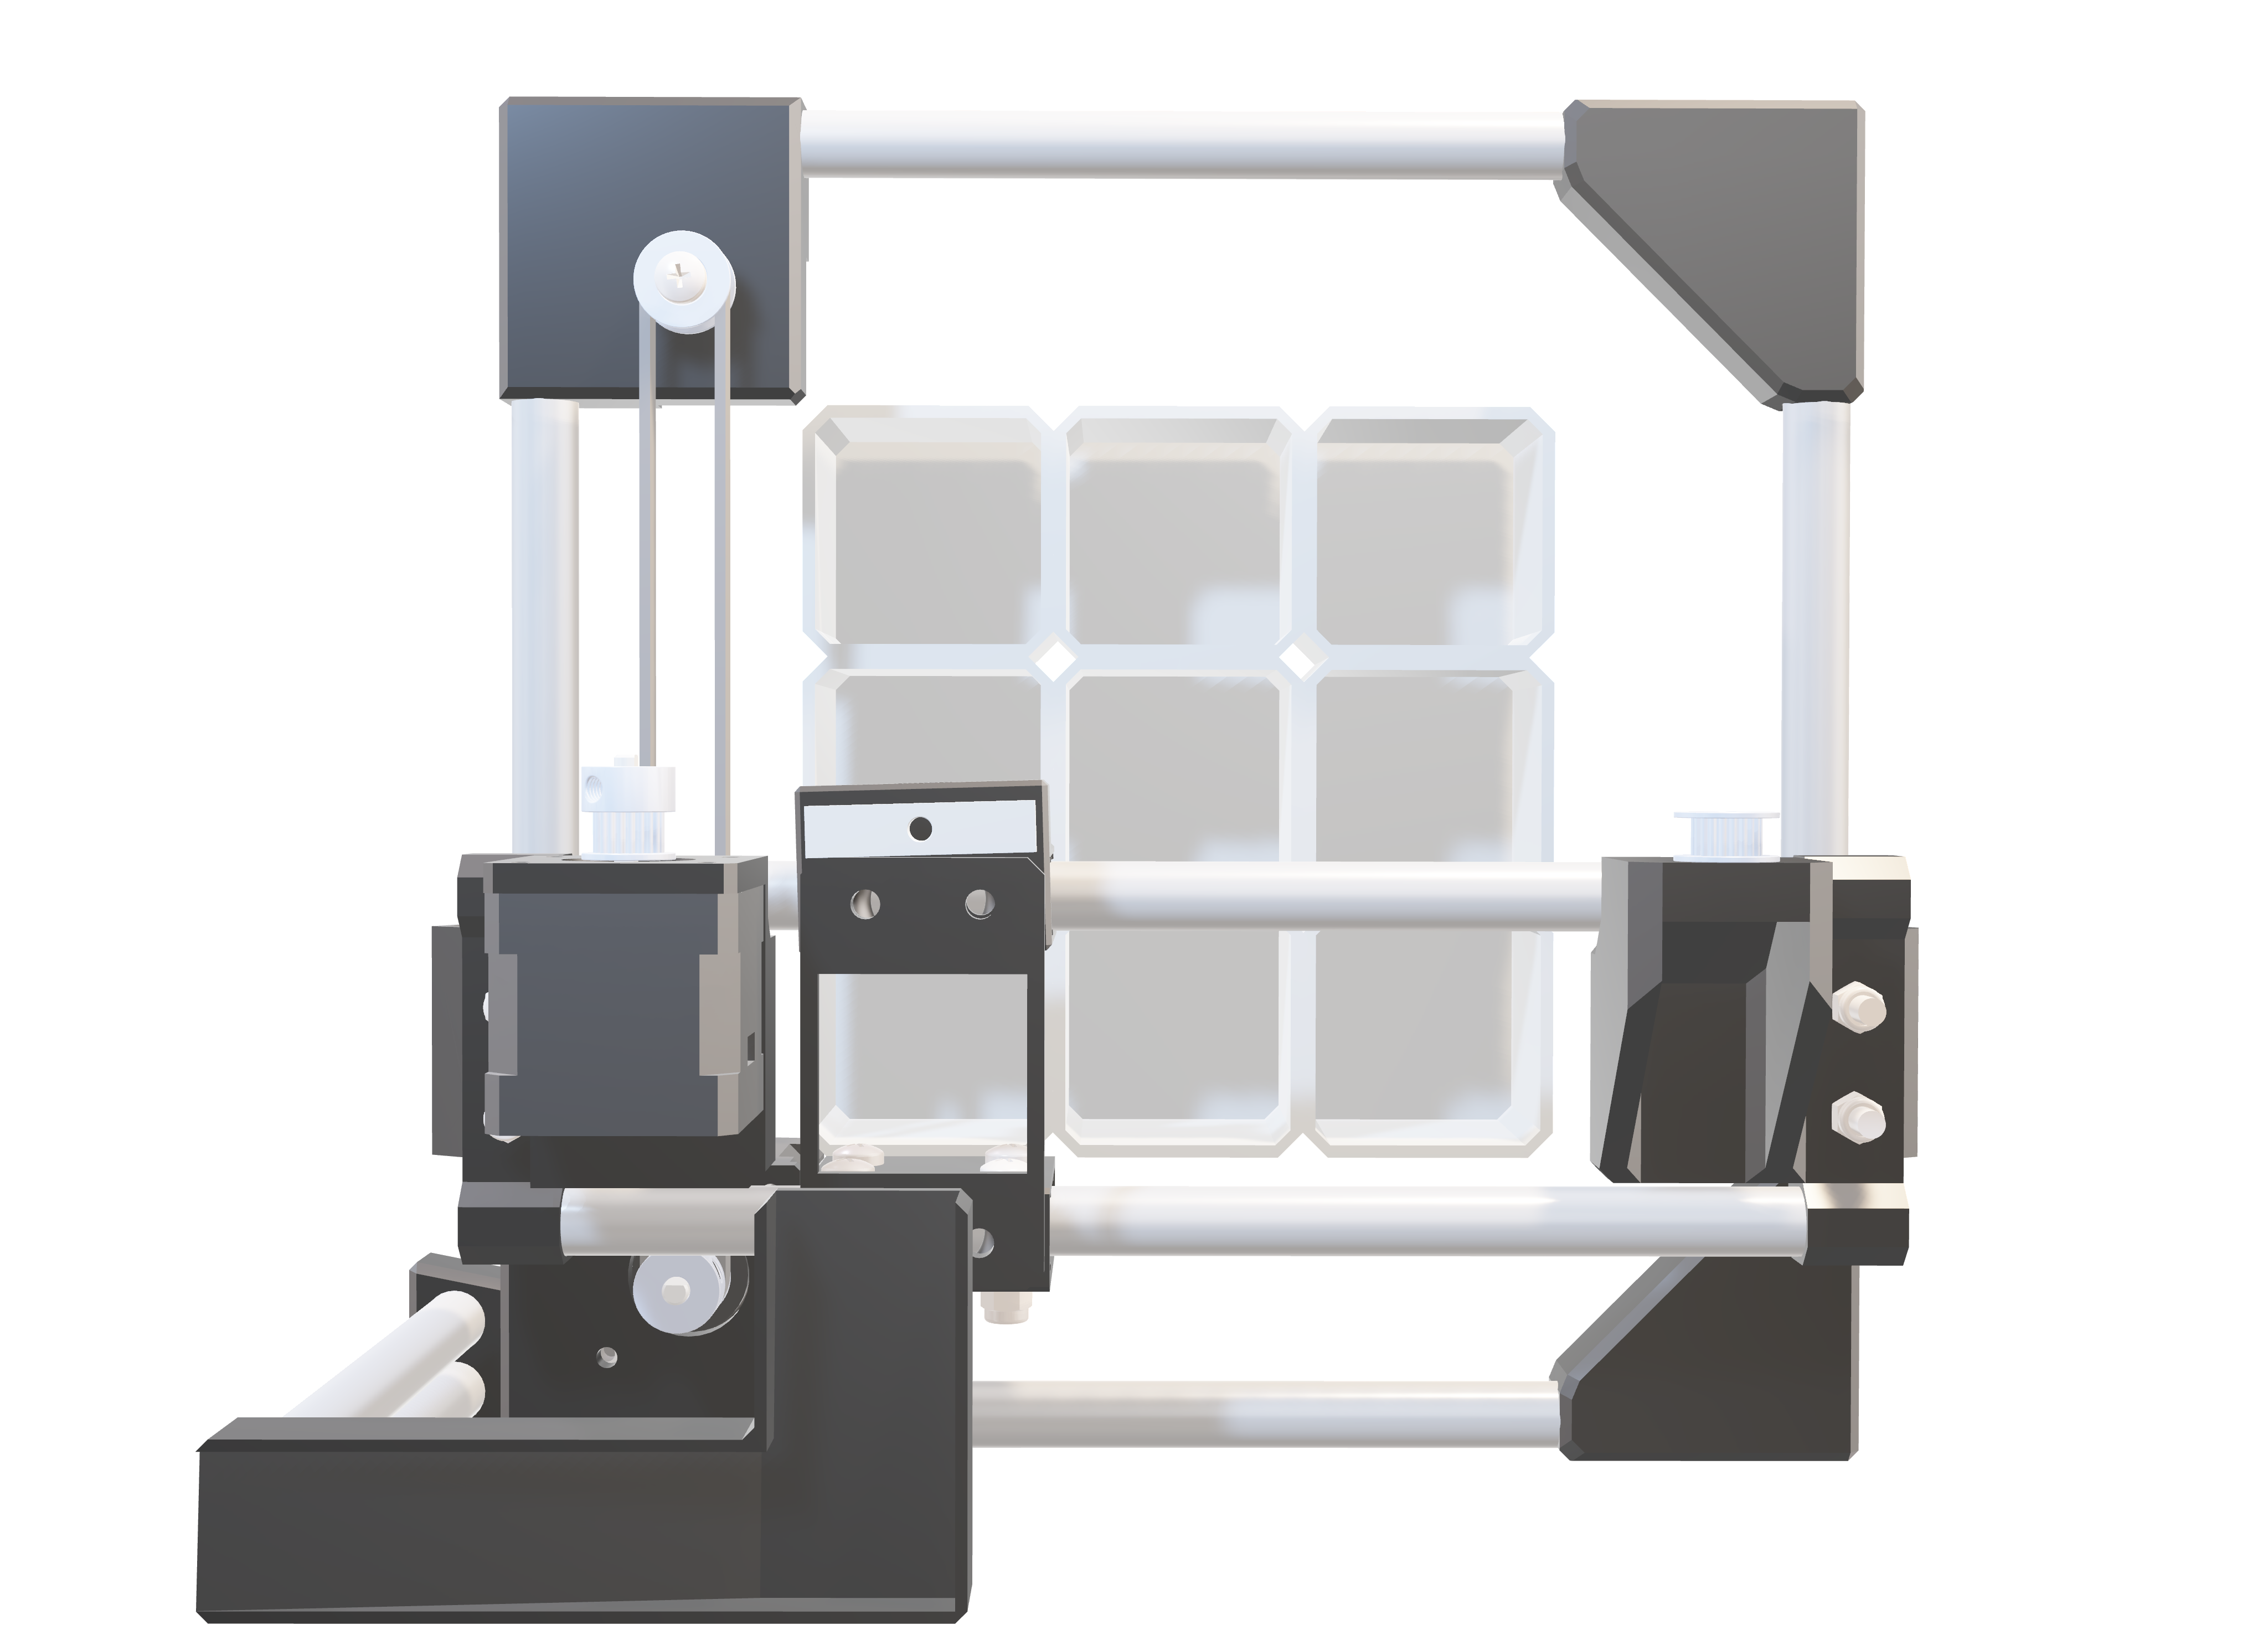
MEET THE TEAM
Anson (Leader)
Ye
Solidworks
Building
Motors and Gantries
Full Stack Dev
Computer Vision
Ai Engineering
Backend Dev.
Kiel
Su
Solidworks
Assist Building
Slide Design
Filming
Frontend Dev.
Assist Backend Dev.
Slides Design

Slide 4
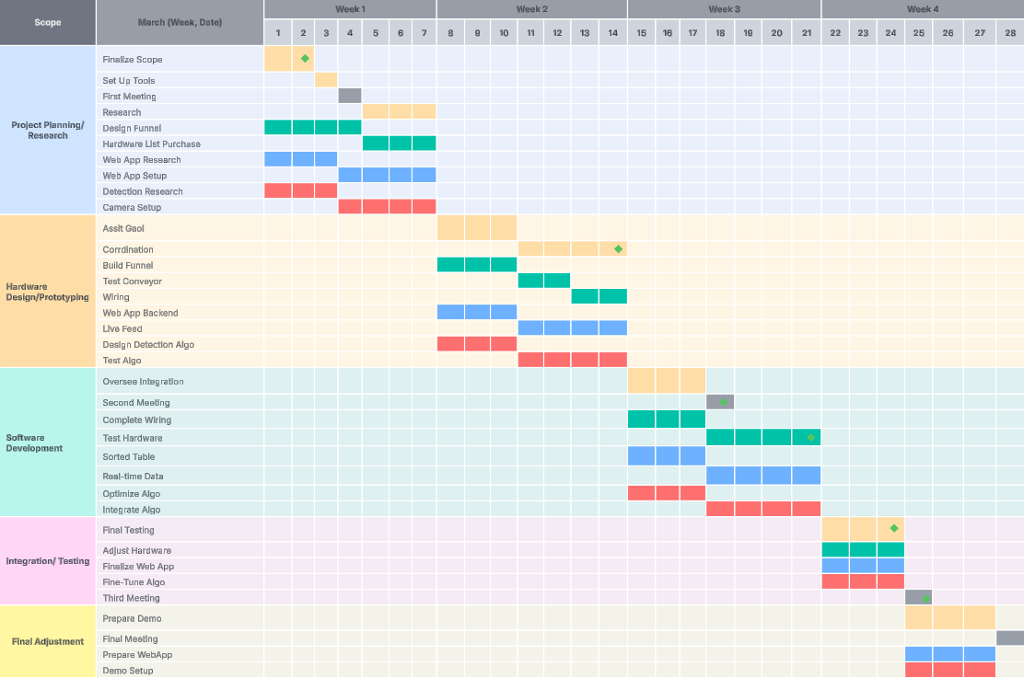
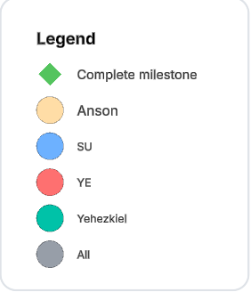
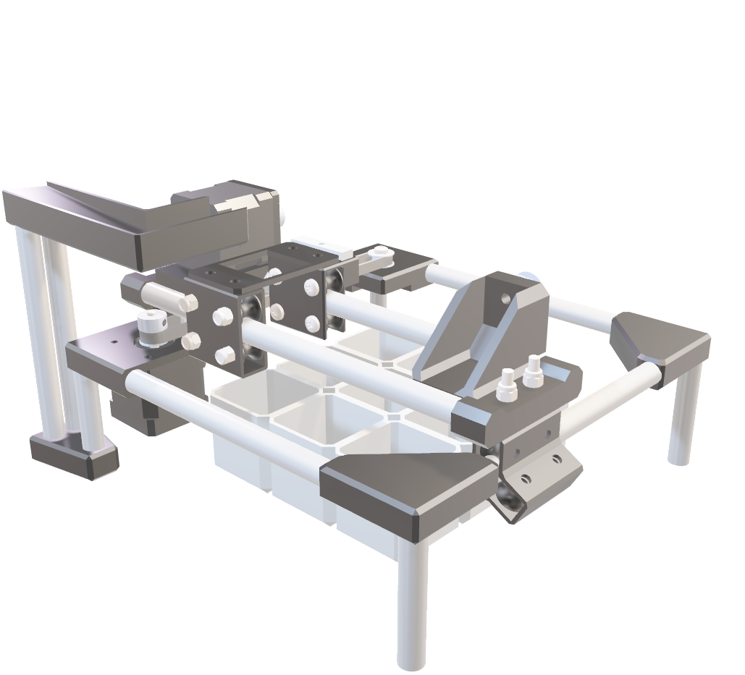
1. Project Scope Finalized
2. Hardware Prototype Completed
3. Halfway Meeting
4. Software Completed
5. System Integration & Testing Completed
6. Final Presentation Ready

Slide 5
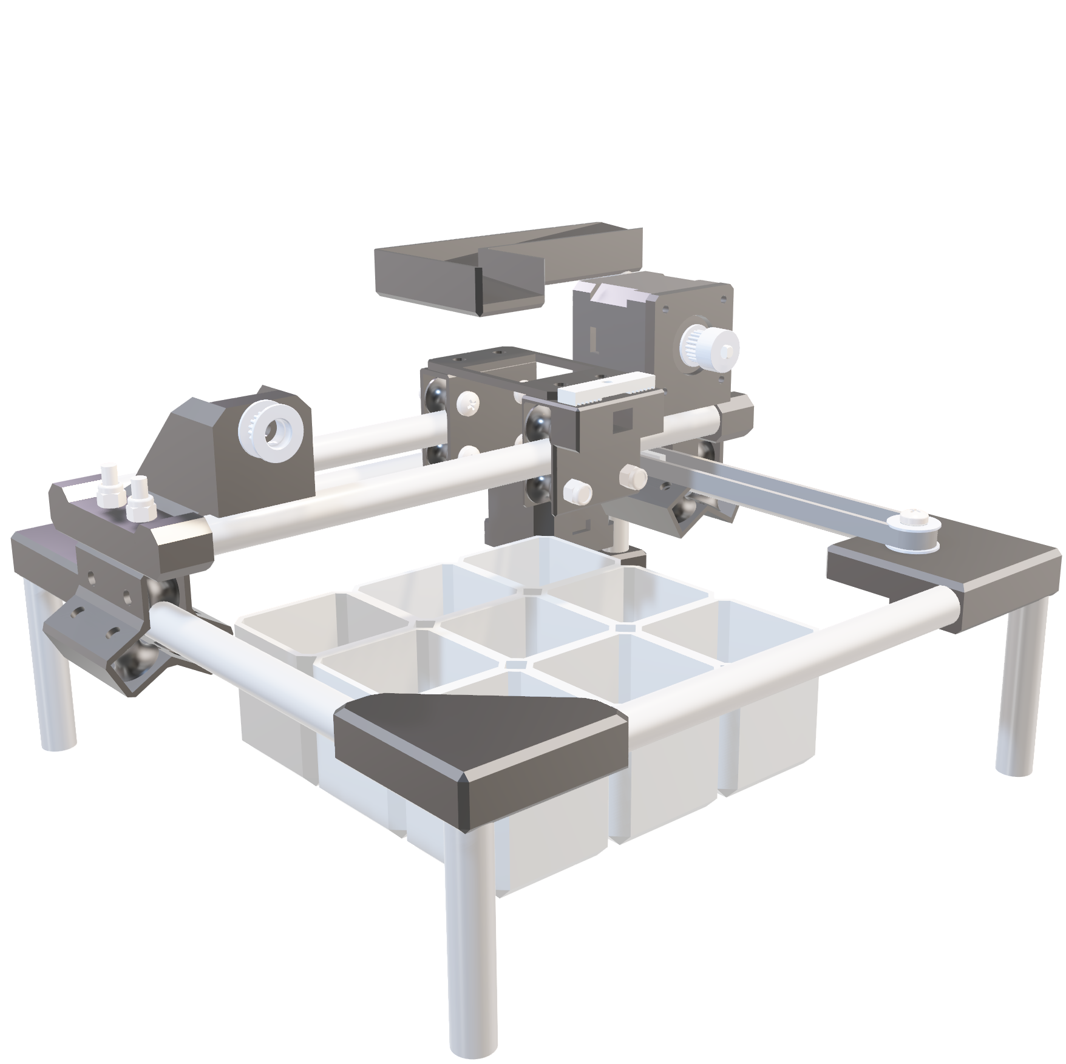
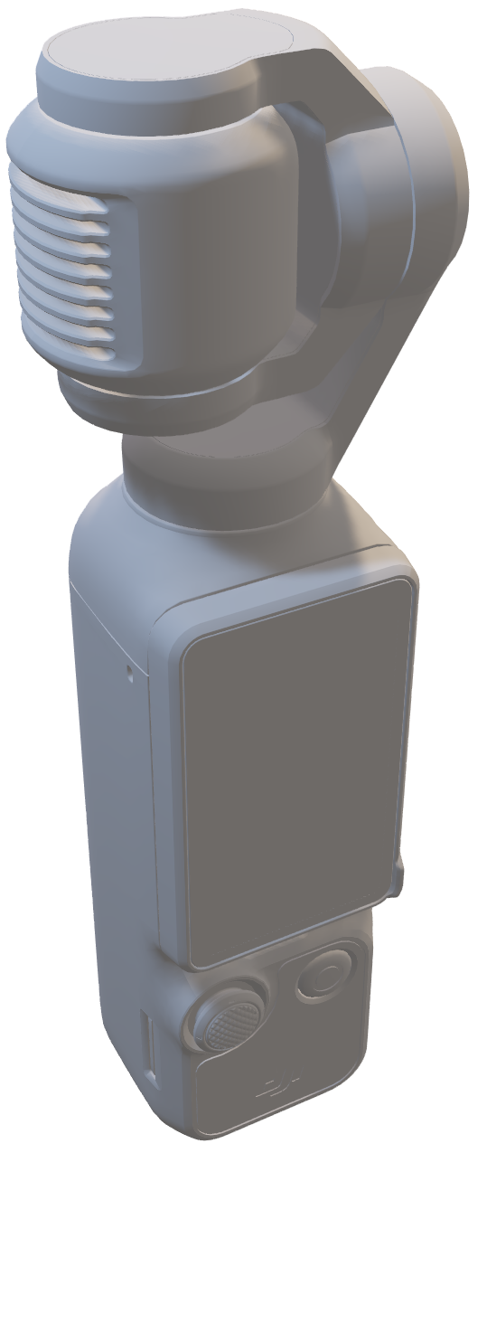
So, what is BRICK by BRICK?
BRICK
BY
BRICK

Slide 6

COMPUTER VISION
Hardware – Software Integration
Computer Vision based classification
Automated movement system
Embedded system development
Local and Real-Time Operation

Slide 7
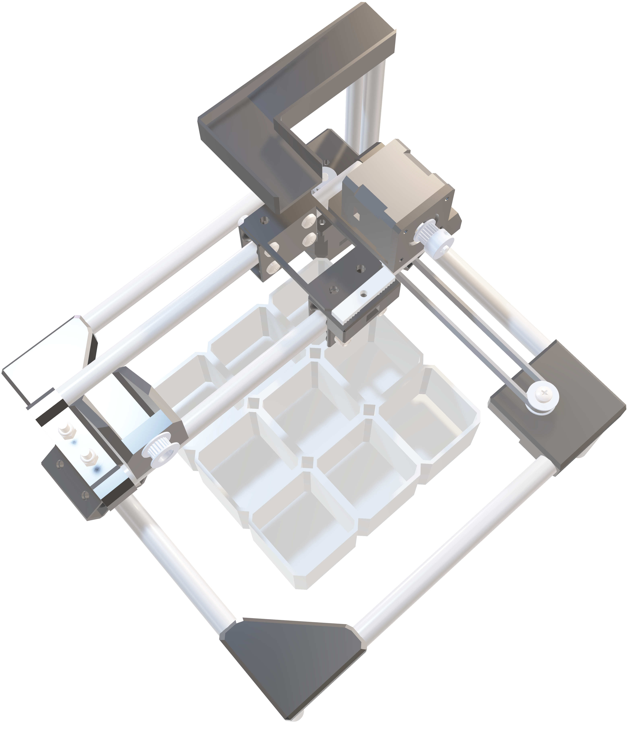
OBJECTIVE
Use embedded system and edge computing for automated object sorting
Use computer vision to detect and classify objects in real time
Design and control an X-Y gantry system for precise placement
Apply embedded system design principles and object-oriented programming from CMPE 246
Develop reactive full-stack application to monitor and control sorting

Slide 8

Prototype

Slide 9
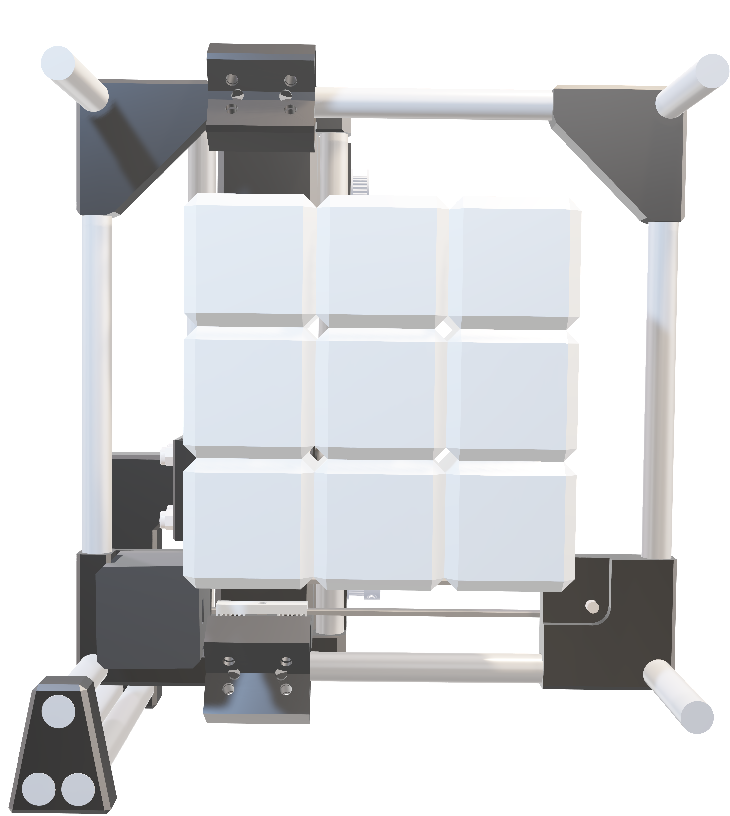
REAL WORLD APPLICABILITY
Warehouse Automation: Item sorting and placement using vision and motors (like a mini Amazon robot arm)
Smart Recycling: Automatically sort waste by type (plastic, metal, etc.) using object recognition
Medical Labs: Classify and organize sample containers or slides
Retail Backrooms: Organize small items (e.g., electronics, accessories) into storage compartments
Home Robotics: Smart drawer or bin that organizes your tools, toys, or screws for you

Slide 10
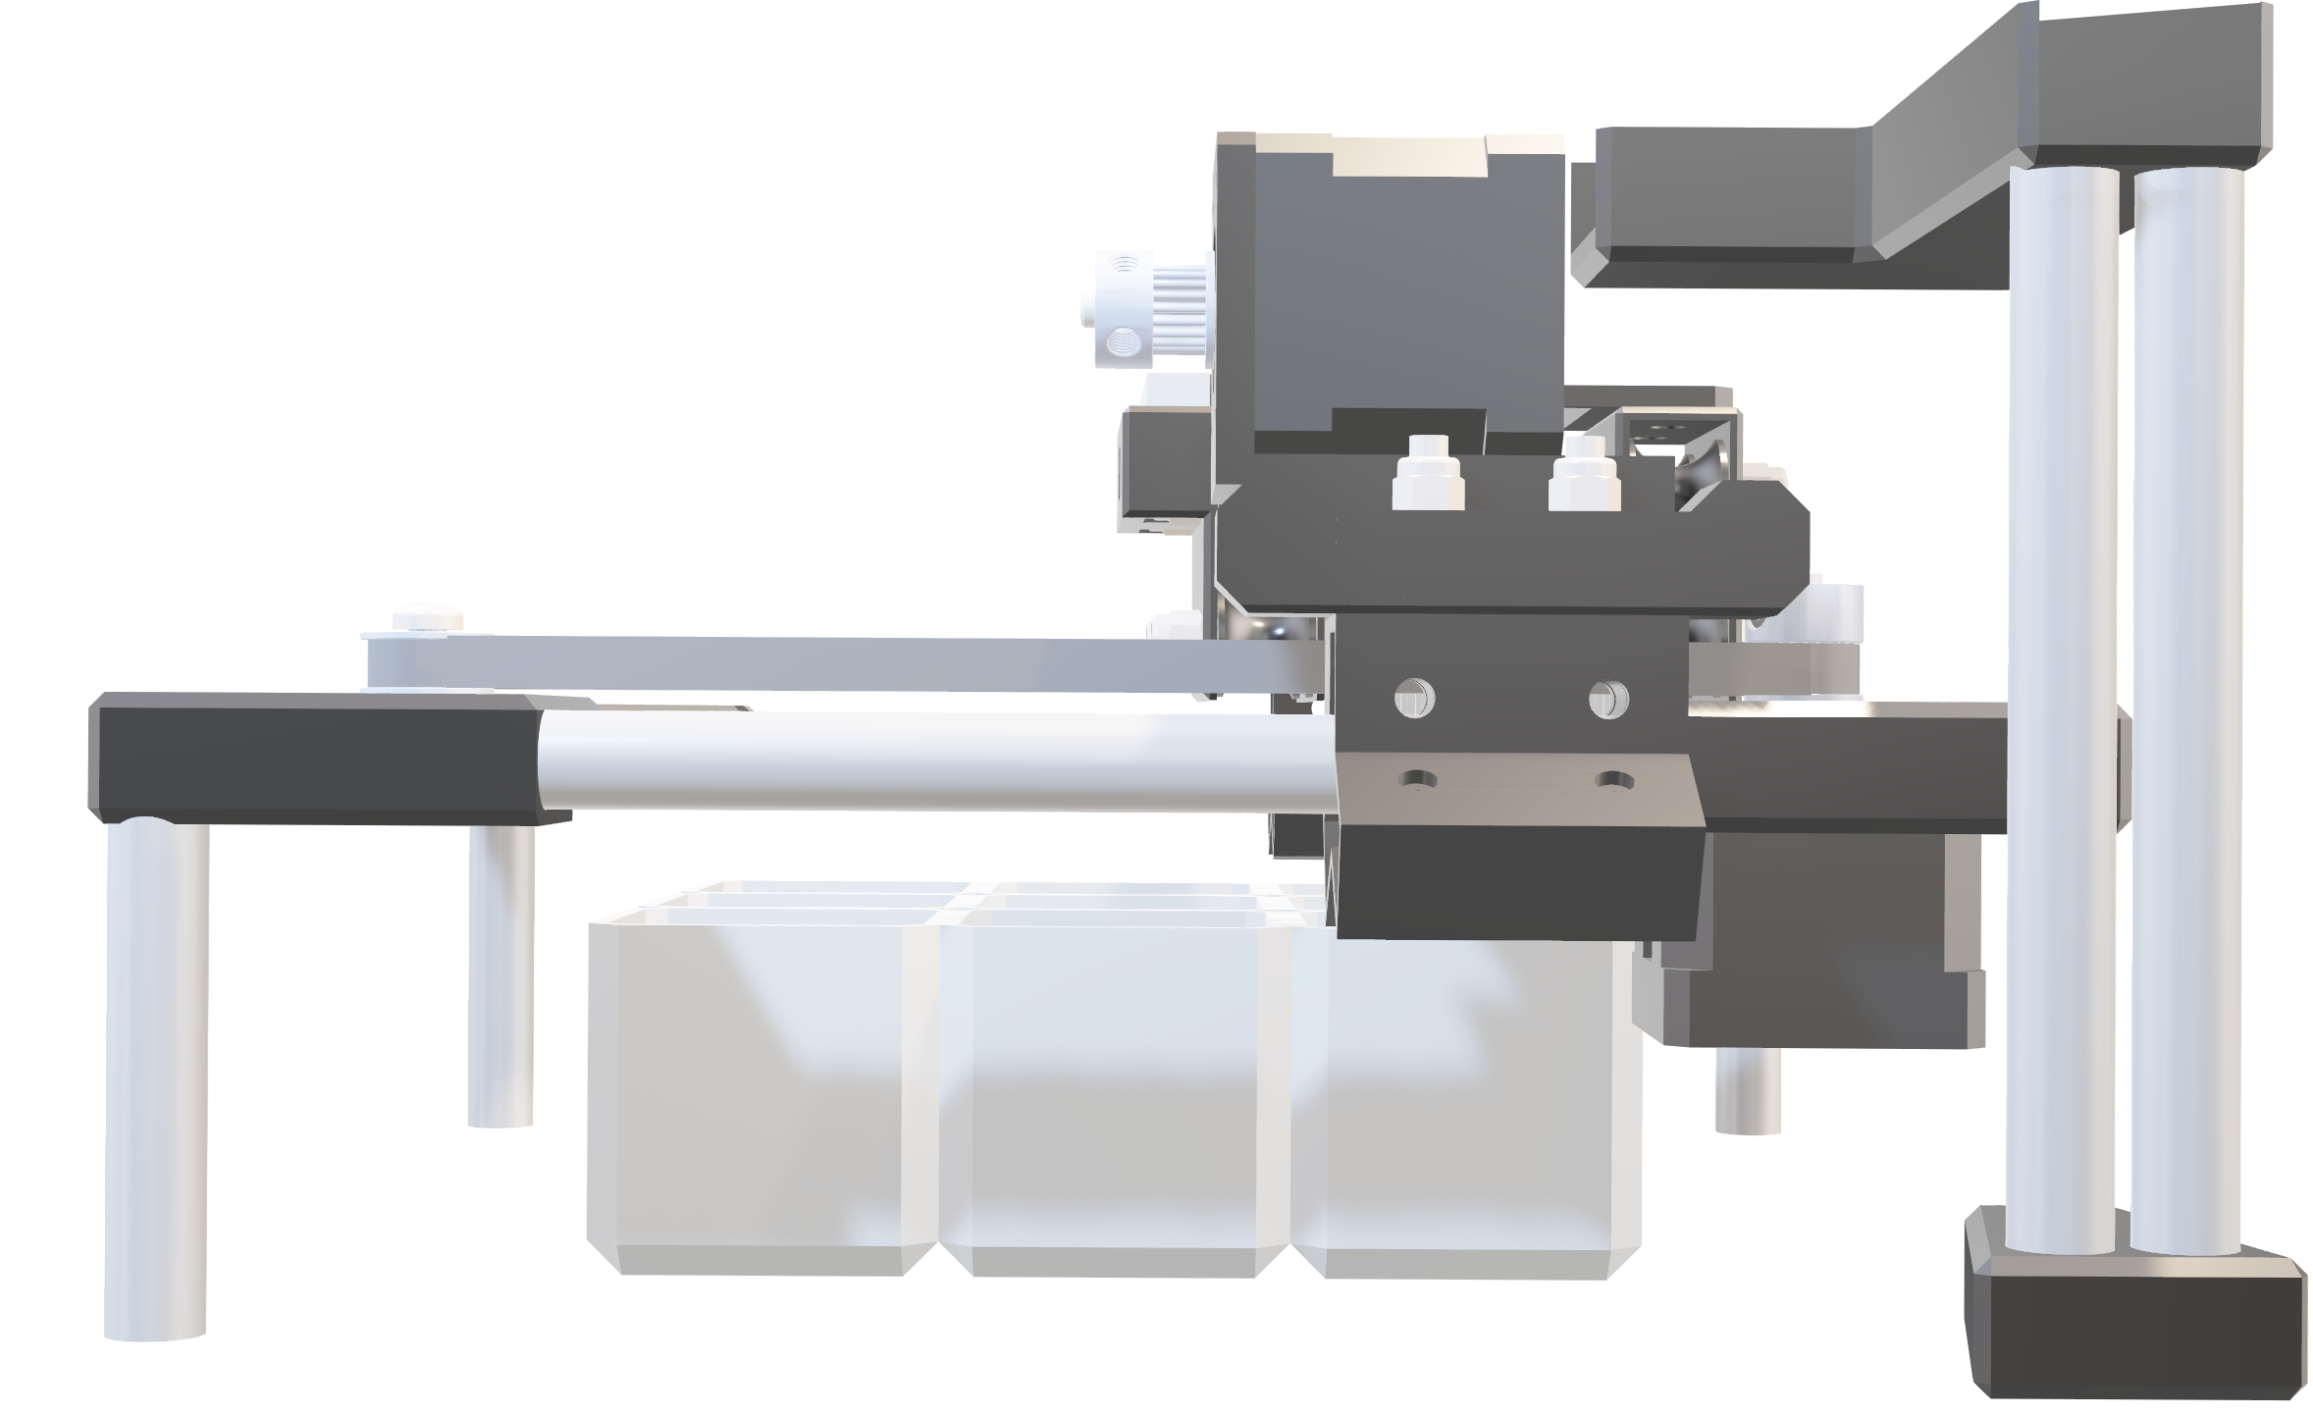
HARD
SOFT
WARE
WARE
Resources
Resources
Raspberry Pi 4B
Camera Module
Stepper Motors / Drivers
DC Motors / Drivers
Servo Motors
Funnel System
Sensors
Power Supply
Breadboard
Python/Typescript/Next.JS/Vite.JS
OpenCV
Flask, Websockets
UART/MQTT communication prot.
Rasbian Distro
Github
Canvas
Blender
Figma
Brickognize API
Solidworks
SQLite3 Database

Slide 11
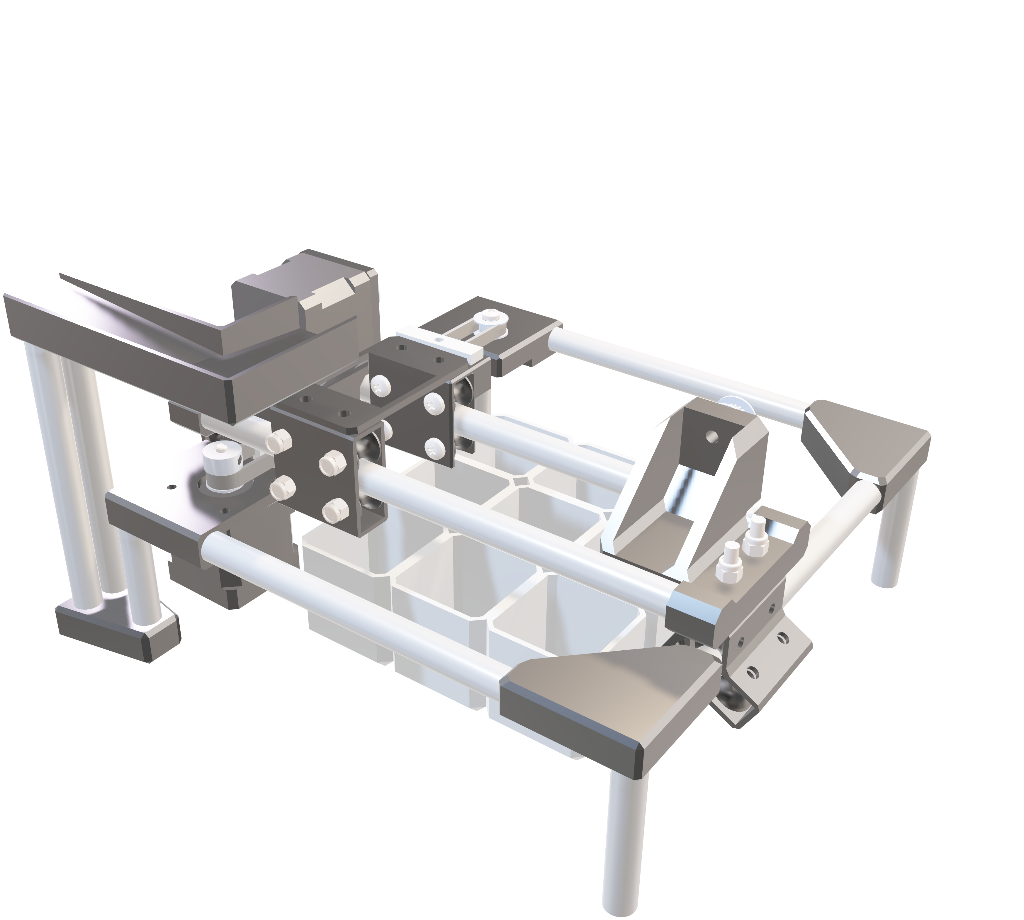
ONLINE
Resources
Brickognize Documentation
OpenCV Tutorials
Raspberry Pi Guides
React bits/Shadcn/Framer motion
ChatGPT/Deepseek
Youtube

Slide 12
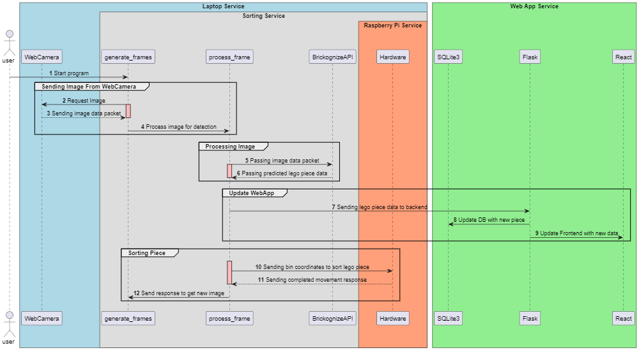

UML

Slide 13
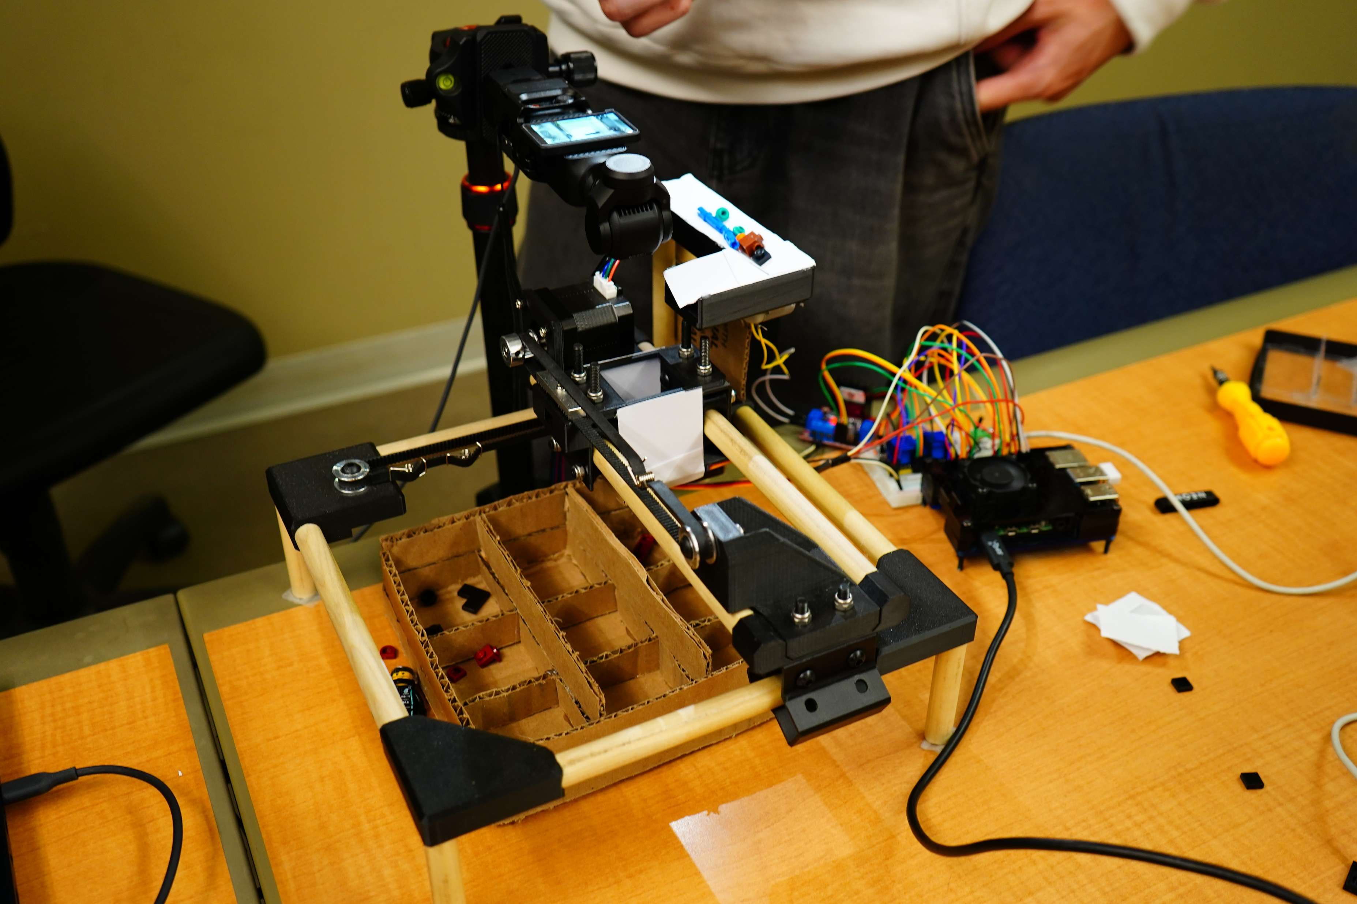

Internal Hardware

Slide 14
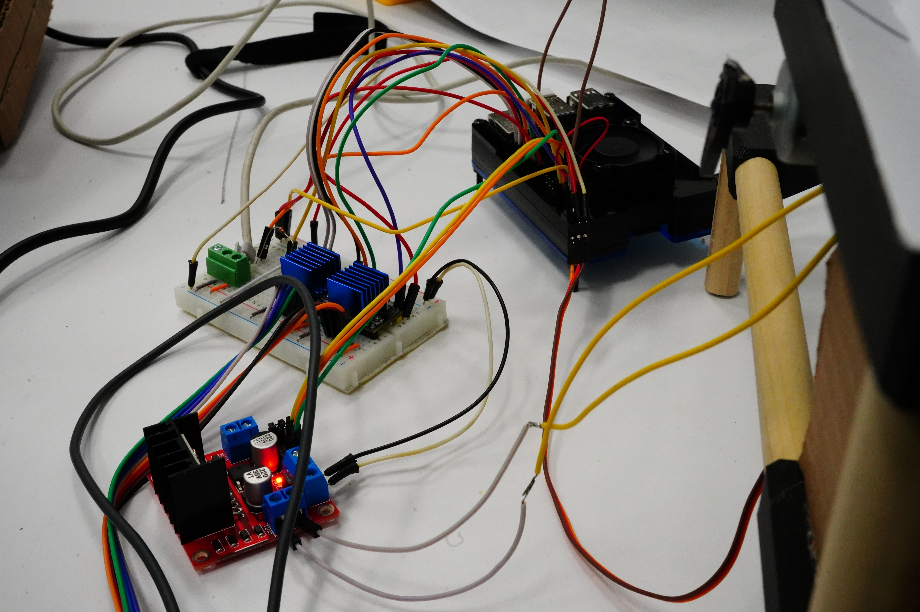

Internal Hardware

Slide 15
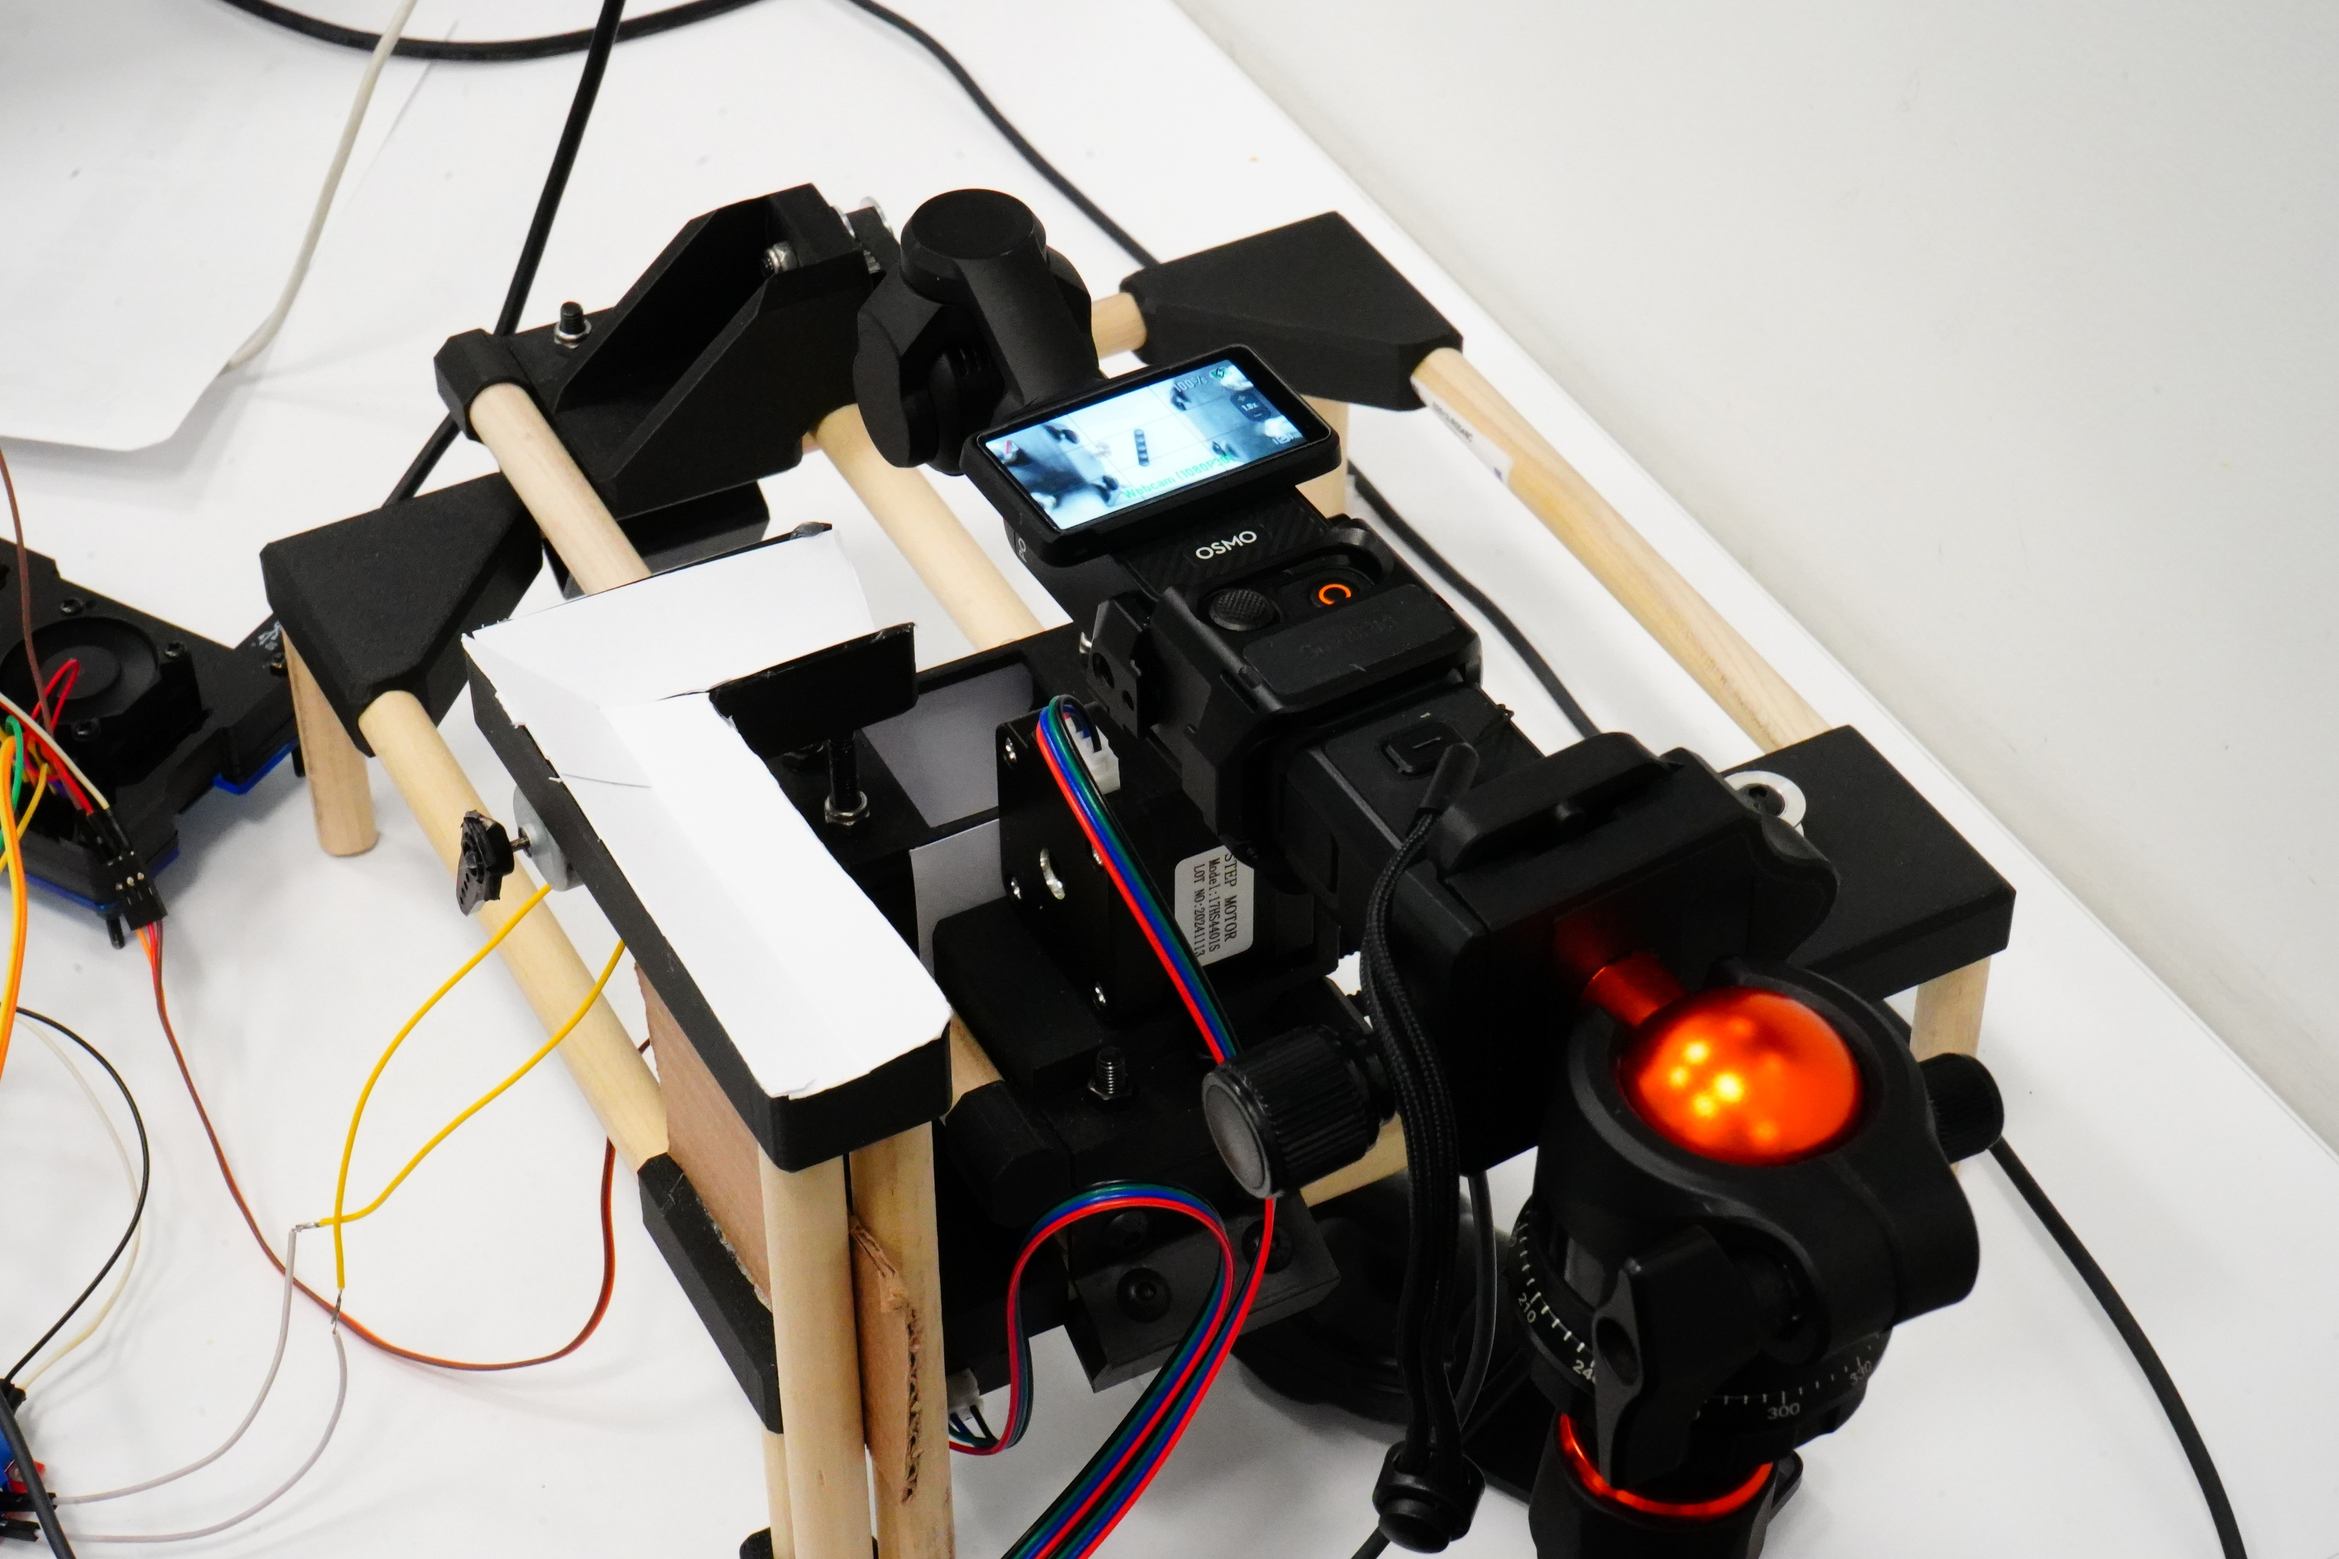

Internal Hardware

Slide 16
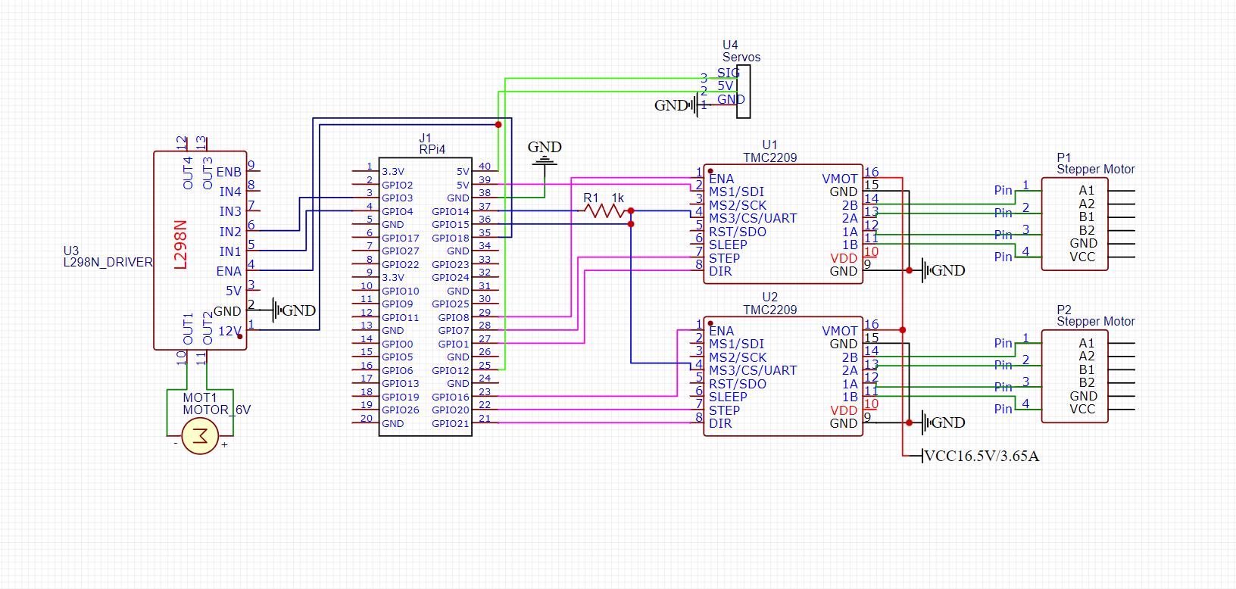

Circuit Diagram

Slide 17
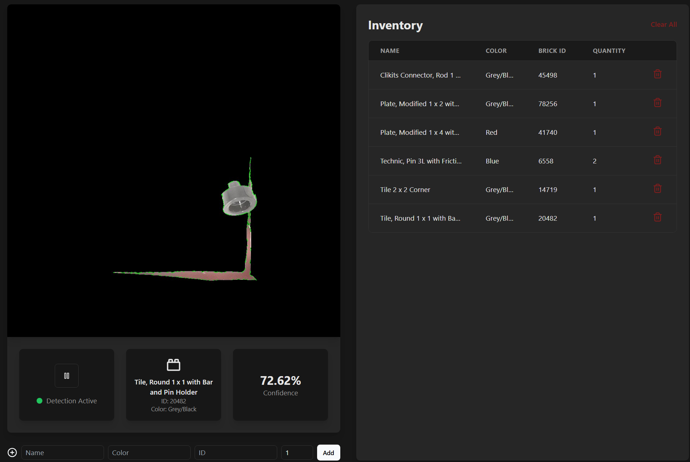

User Interface

Slide 18
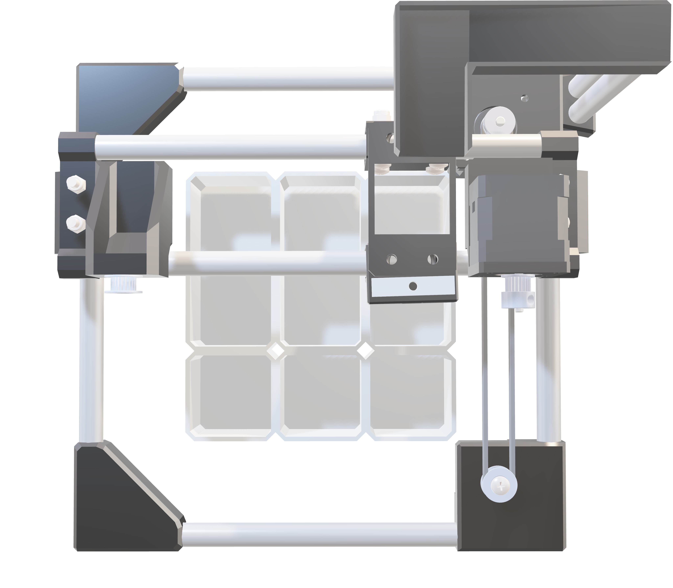
Personal
Insight

Slide 19
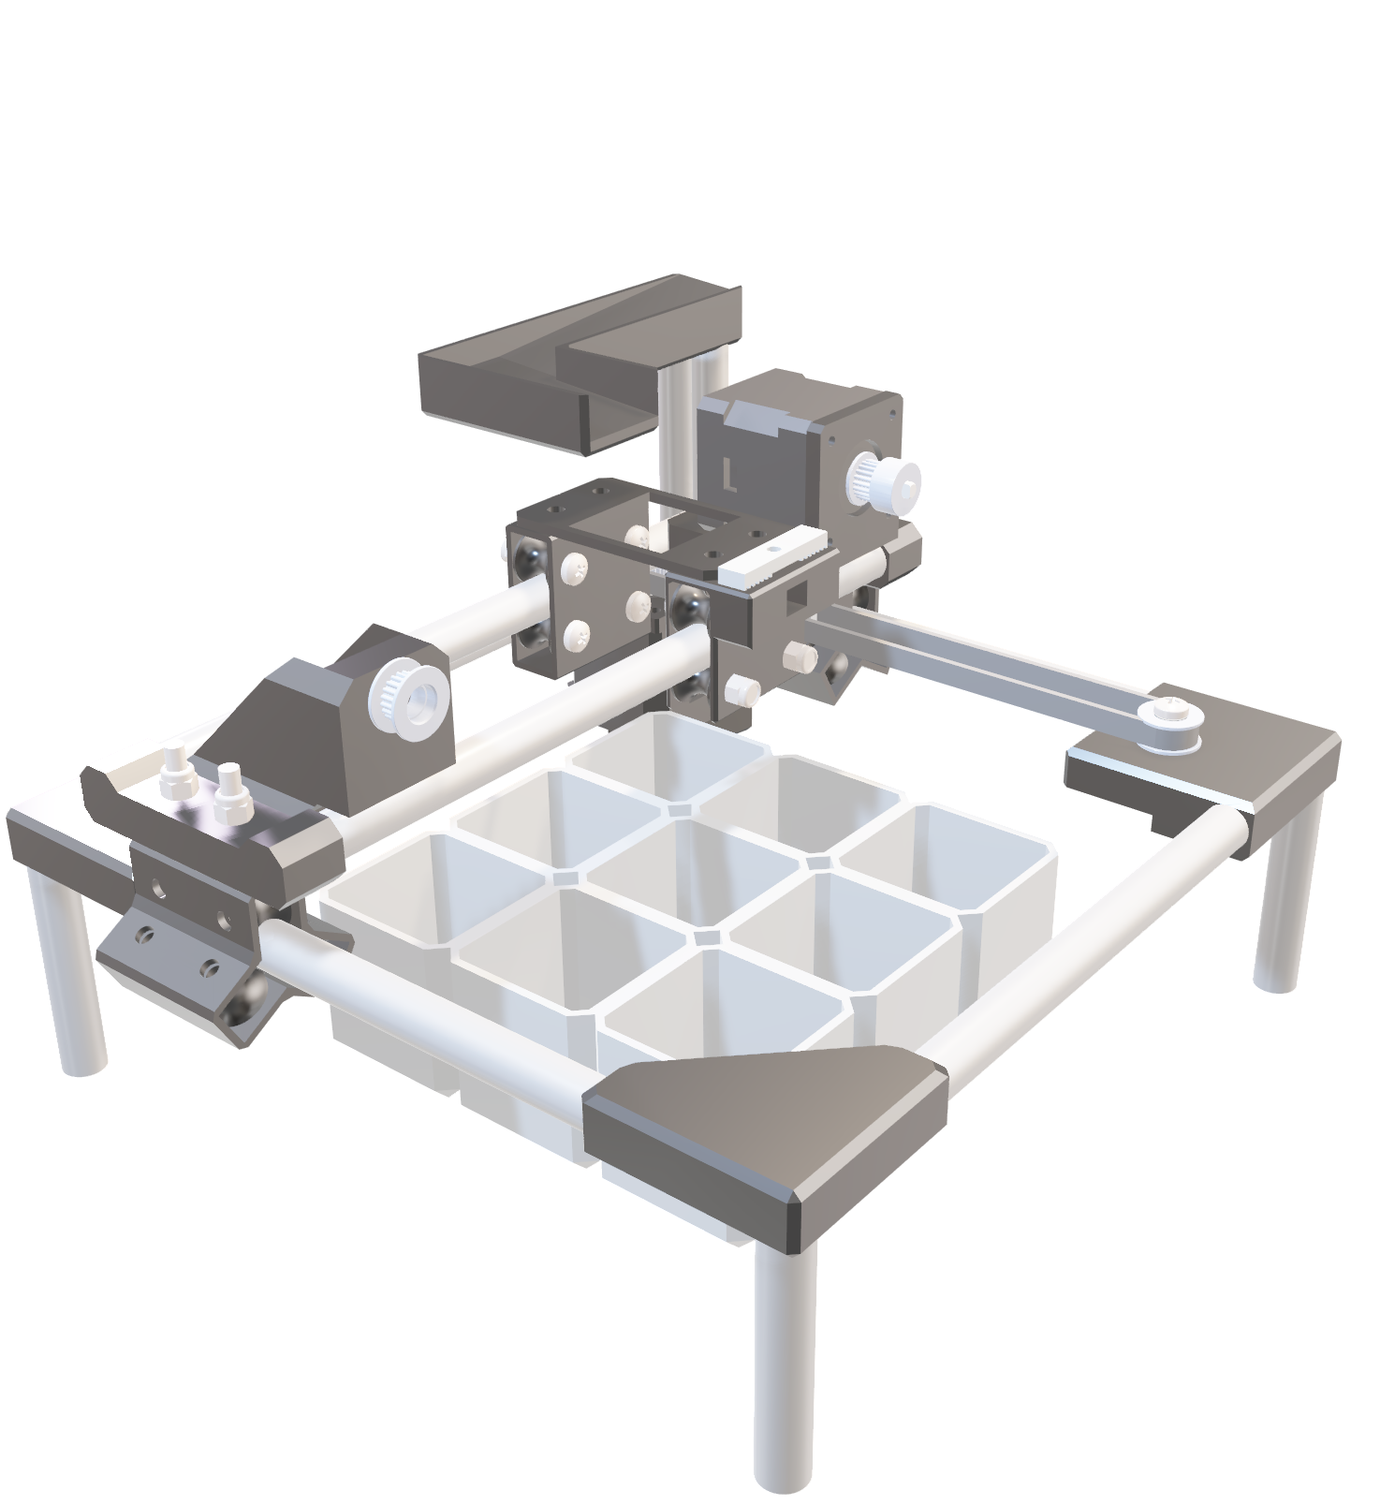
VIDEO
DEMO

Slide 20
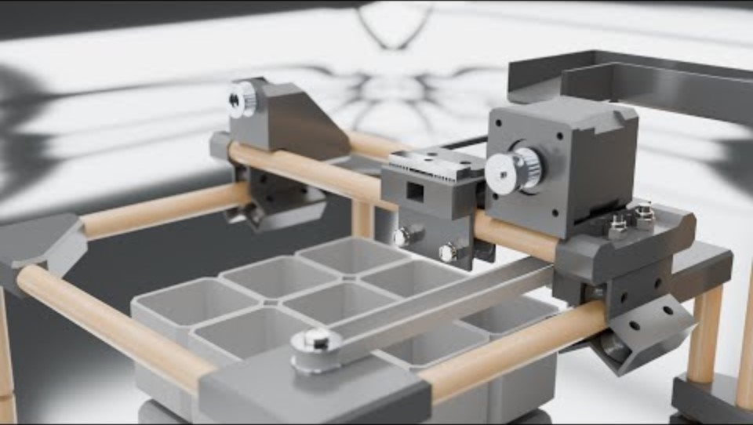
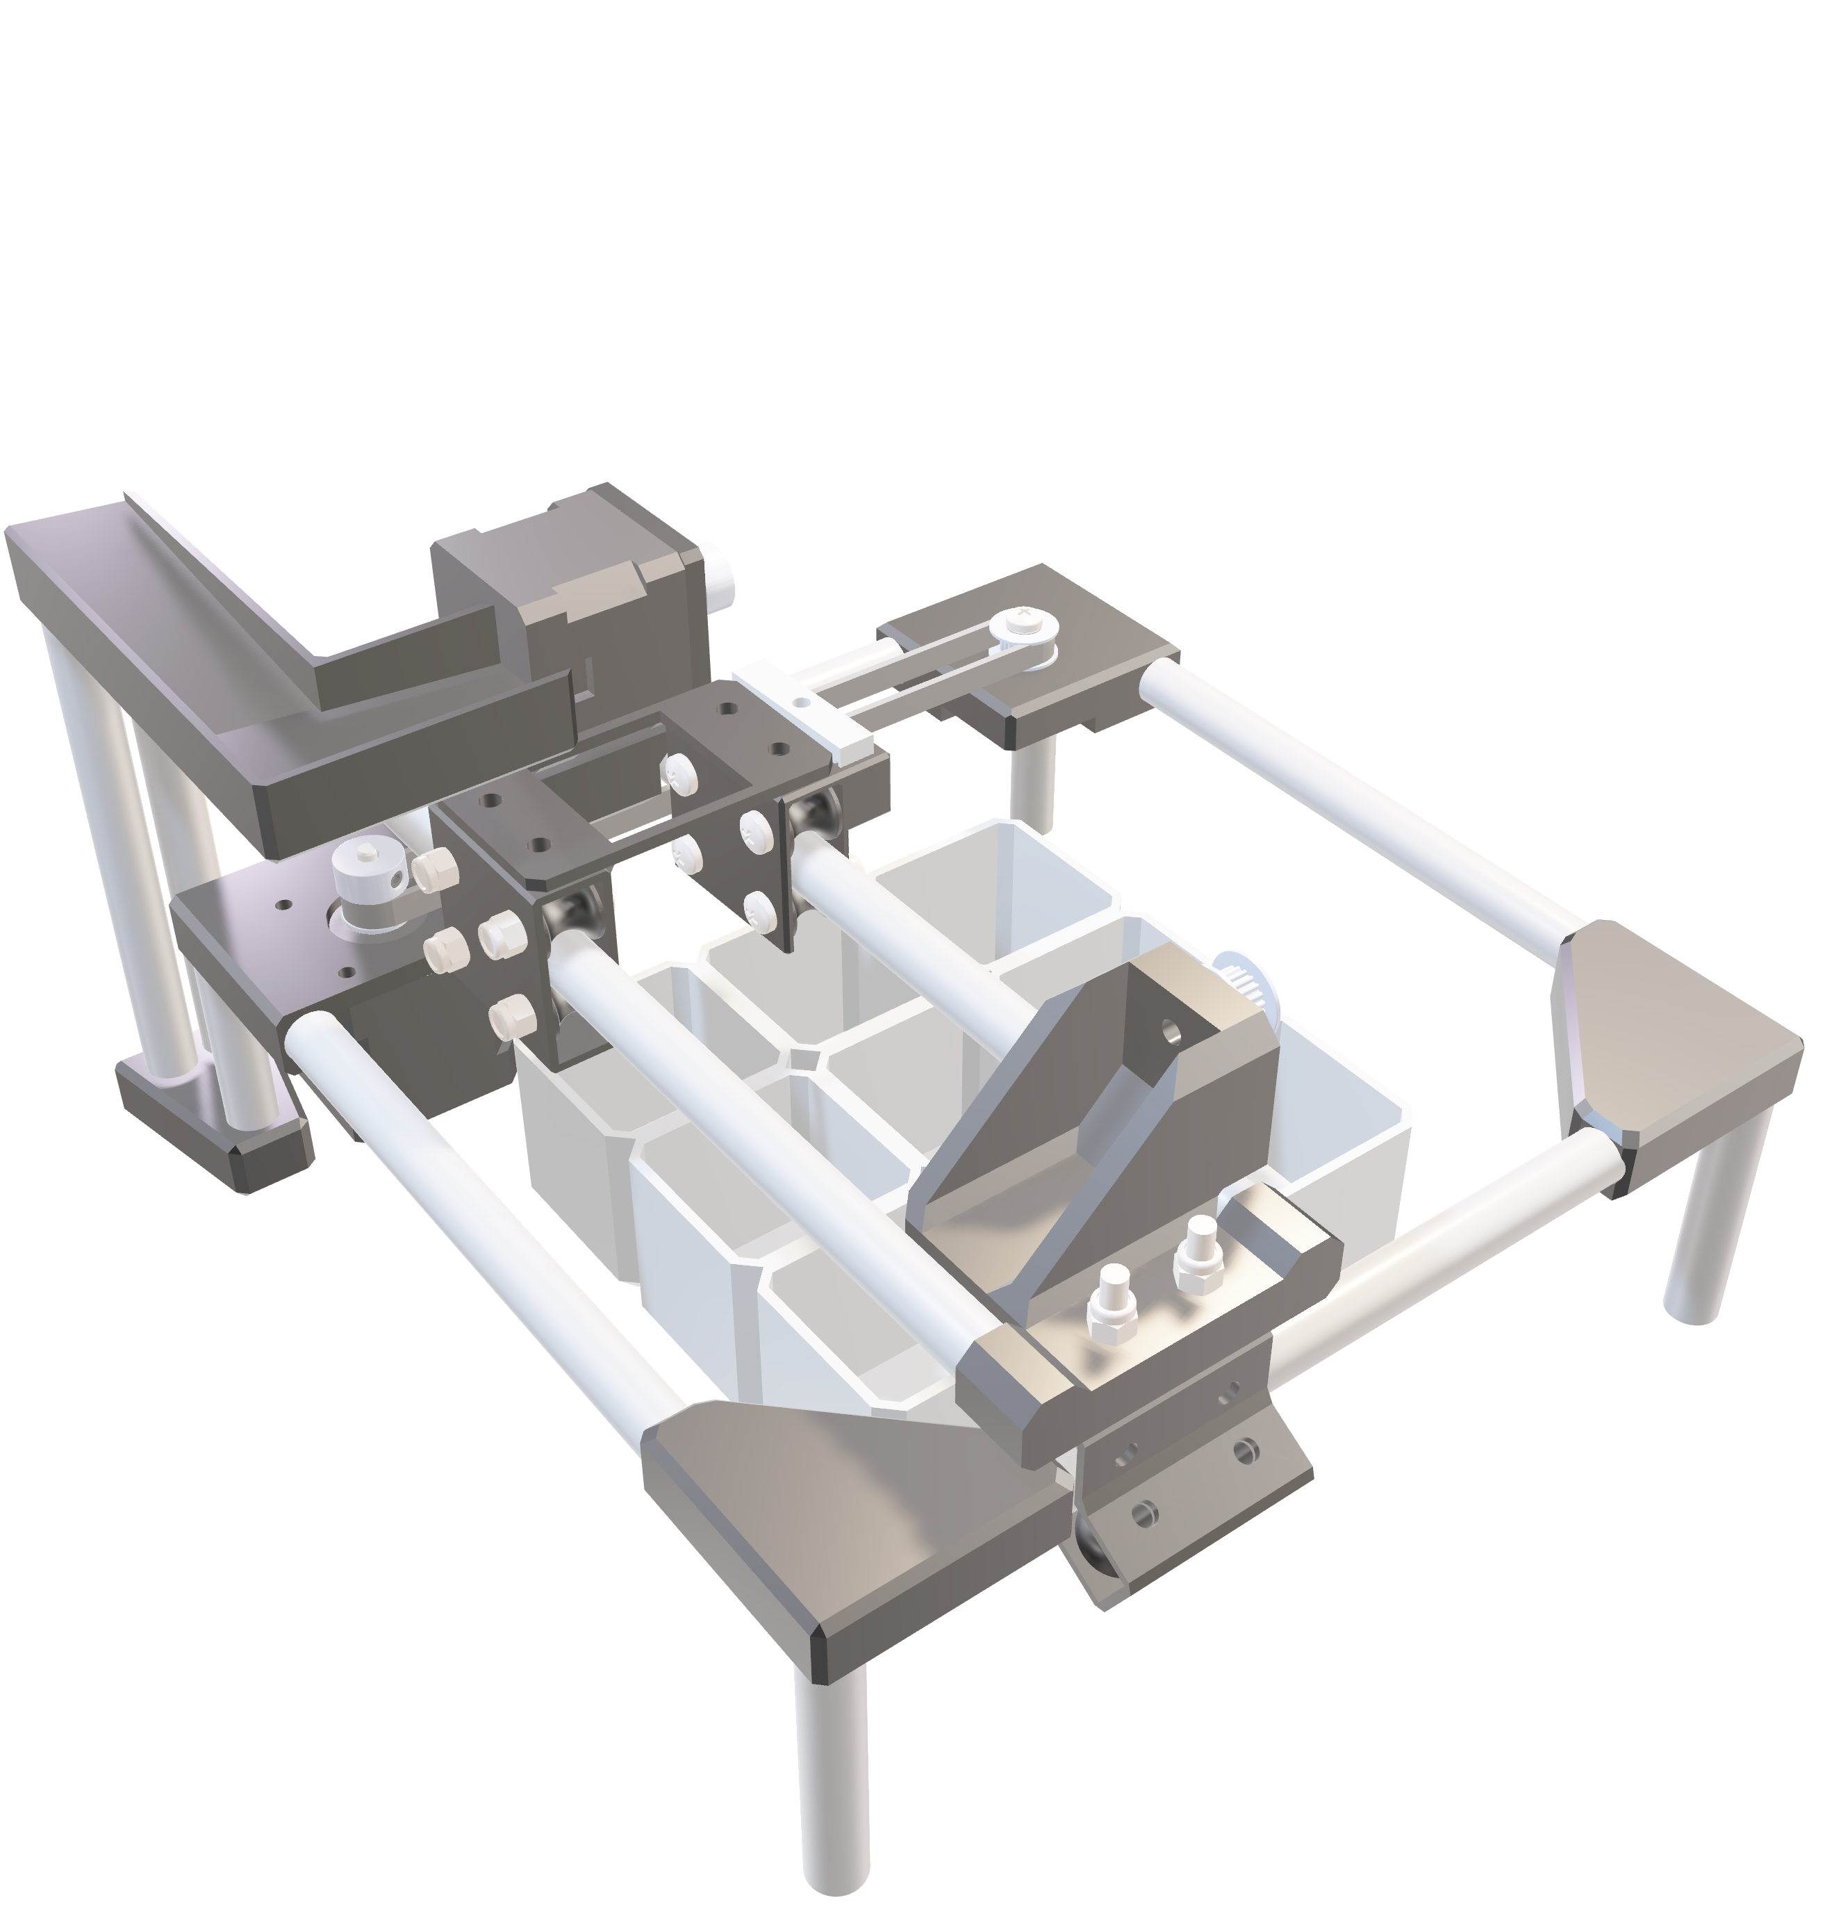
VIDEO
DEMO

Slide 21




More About this Project
Github
Feedback
YouTube

Slide 22
THANK
CMPE Project – Group #11
YOU!!!

